Slide 1
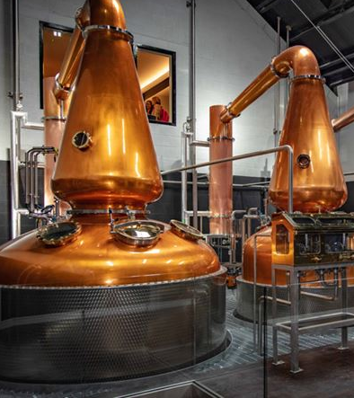
IOWA Whiskey Distribution
Network science project
July 27, 2021

Slide 2
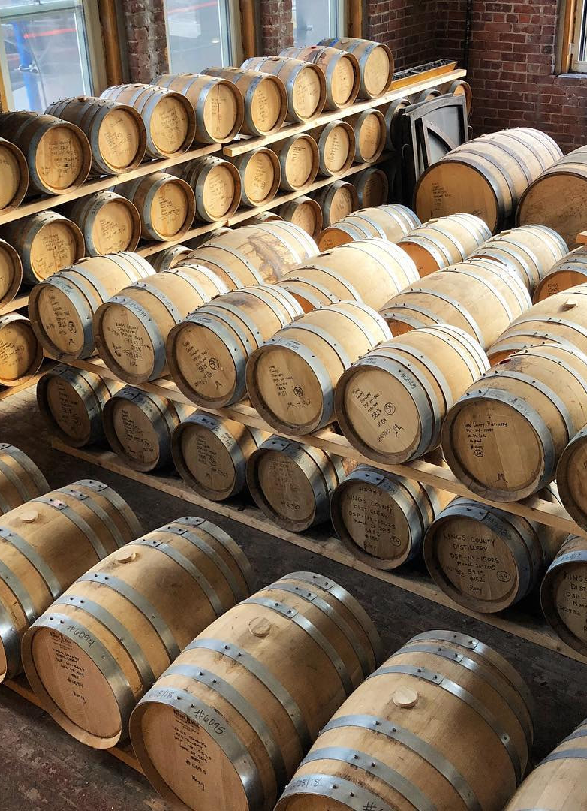
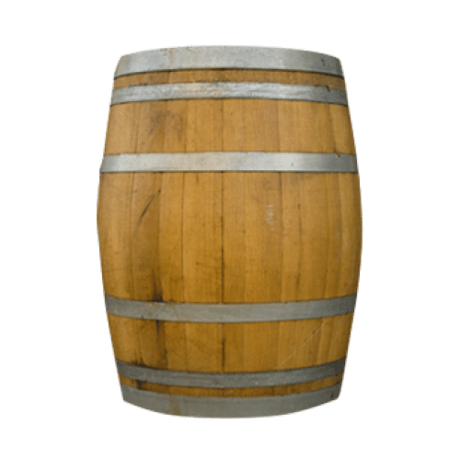
Business background
I am putting myself in the shoes of a Data Scientist working for a whiskey distillery tasked with understanding and optimizing the retail sales channels.
Specifically, we would like to begin distribution in Iowa but don’t know what vendor to use and which stores/areas to target with our initial launch.
The product is American made but in the Irish Whiskey tradition. This means we need a distributor who specializes in both types of products.
Notes:
Small whiskey distillery that specializes in Irish styles
Looking to begin expanding into Iowa
Small budget to begin testing but don’t know where to start

Slide 3
Purpose of the analysis
What questions are we trying to answer or what problems are we trying to solve?
What distributor should we target to get our product into stores?
What geographic area and stores should we target first?
Notes:
-103 Distributors of whiskey to Iowa
-99 Counties
-Over 1800 liquor stores

Slide 4
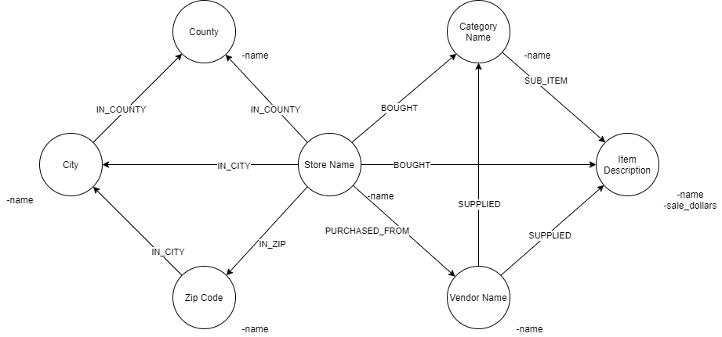
Data Source & Data Model
Data Source
Our data is hosted on BigQuery in their public datasets bigquery-public data.iowa_liquor_sales.sales
Over 21.6 million records each of which is an individual product purchase.
24 columns that fall into the below three categories:
  Location of stores purchasing the alcohol
  Information about the product
  Metrics around quantity and price.
Data Model
Notes:
This dataset fits my need (can answer my business questions)

Slide 5
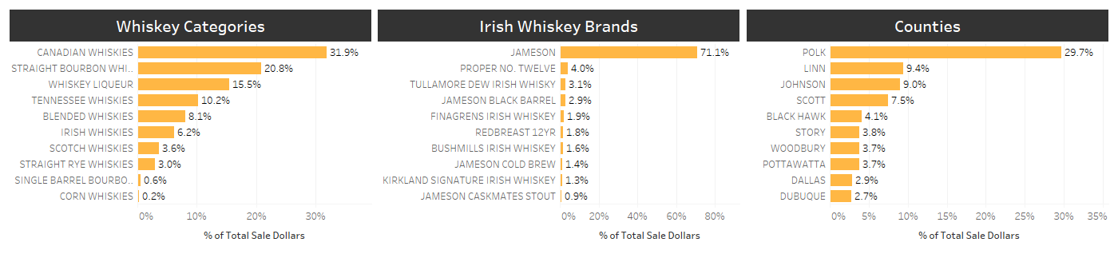
Exploratory analysis – Top values

Slide 6
Business Questions:
What distributor should we target to get our product into stores?
What geographic area and stores should we target first?

Slide 7
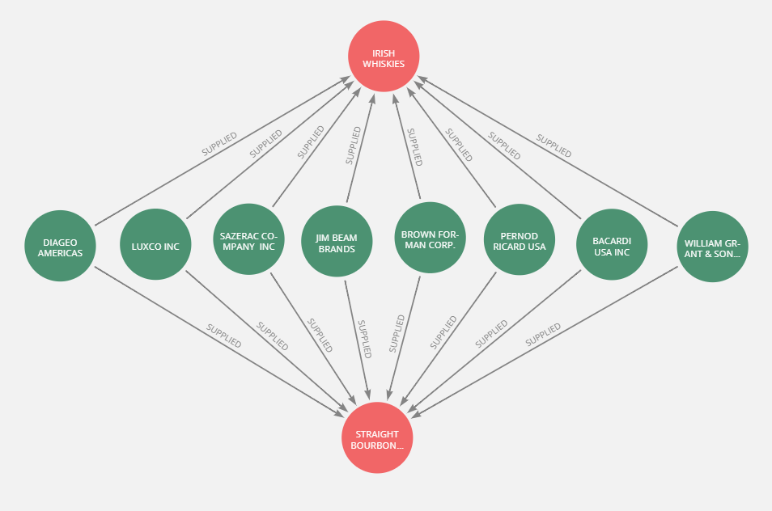
Recommendation – Question I
What distributor should we target to get our product into stores?
Pernod Ricard USA
Diageo Americas
Luxco Inc.
Sazerac Company Inc.
Jim Bean Brands
Brown Forman Corp
Bacardi USA Inc.
William Grant & Sons Inc.
Notes:
Left with 8 vendors who currently distribute Irish and Bourbon whiskies and are the most connected to stores in Iowa

Slide 8
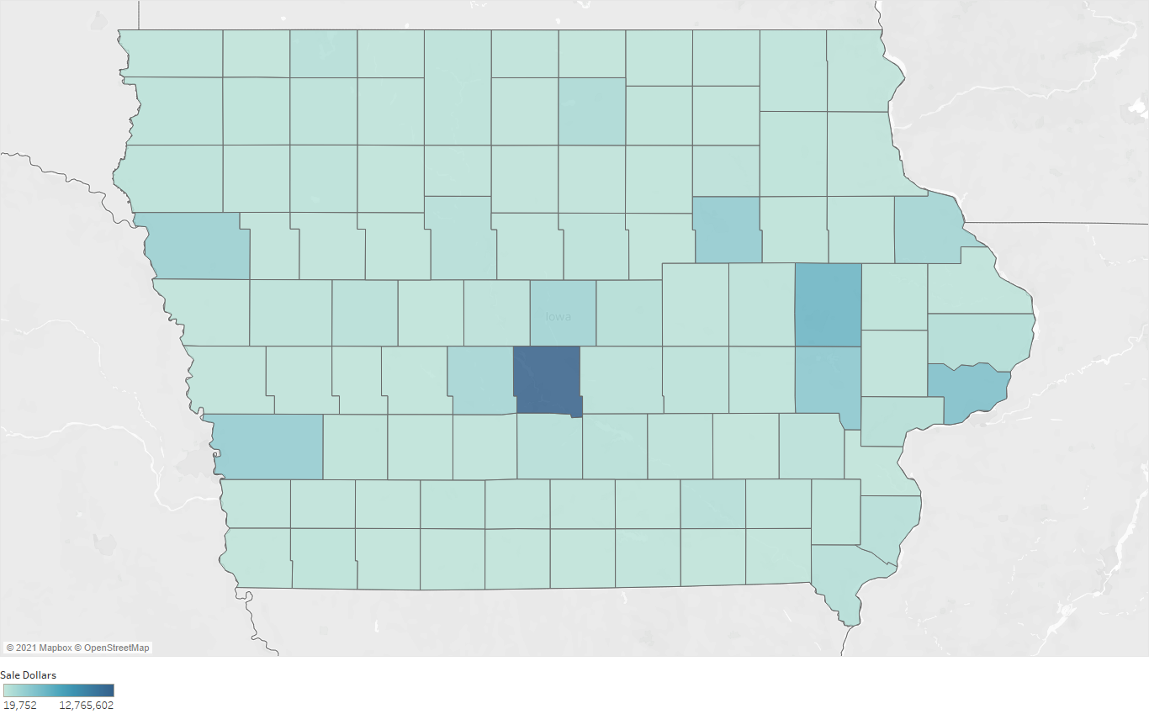
Recommendation – Question II
What geographic area and stores should we target first?
Des Moines in Polk County
Our target distributor (Pernod Ricard USA) distributes to all these stores
Zip Code | Stores
50317 | 16
50313 | 11
50315 | 9
50321 | 8
50310 | 6
*Iowa counties by sales (dollars) of Irish Whiskies

Slide 9
Questions?

